Slide 1
Improving Cybersecurity Posture for Boldi AG

Slide 2
Agenda
1
Introduction: Cybersecurity Posture Enhancement
2
Understanding Cybersecurity: Key Concepts
3
Risk Analysis: Importance and Process
4
Backup Systems: Critical Importance
5
Monitoring and Surveillance: 24/7 Coverage
6
Cybersecurity Vulnerabilities: Identification and Patching
7
Security Measures: Multi-Layered Approach
8
Training and Awareness: Employee Education
9
Incident Response Plan: Preparedness and Execution
10
Regulatory Compliance: Meeting Industry Standards
11
Digital Resilience: Adapting to Cyber Threats
12
Conclusion: Enhancing Cybersecurity Posture for Boldi AG

Slide 3
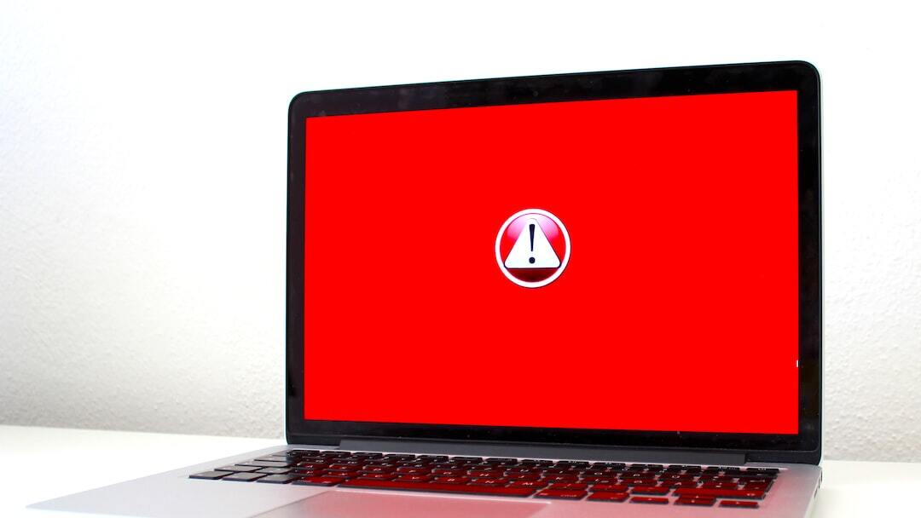
Introduction: Cybersecurity Posture Enhancement
Current Situation: Boldi AG is facing a critical cybersecurity challenge following a recent ransomware attack on a competitor. This incident has highlighted the urgent need for improving Boldi AG's cybersecurity posture to prevent similar attacks.
Ransomware Attack Impact: The ransomware attack on a competitor serves as a wake-up call for Boldi AG to enhance its security measures. The consequences of such attacks can be severe, including data loss, business disruption, and reputational damage.
Identified Vulnerabilities: Boldi AG has identified specific weaknesses in its current cybersecurity defenses that could potentially be exploited by attackers. These vulnerabilities must be addressed promptly to strengthen the overall security posture.
Outdated Risk Analysis: The last information risk analysis conducted by Boldi AG was in 2014, indicating a significant gap in assessing and mitigating current cybersecurity risks. Updating the risk analysis is crucial for identifying new threats and vulnerabilities.
Photo by Michael Geiger on Unsplash
Notes:
Boldi AG's cybersecurity posture requires immediate attention and enhancement in light of a recent ransomware attack experienced by a competitor. This presentation will discuss the current situation, the impact of the attack, identified vulnerabilities, and the importance of updating the outdated risk analysis to fortify Boldi AG's defenses against cyber threats.

Slide 4

Understanding Cybersecurity: Key Concepts
Cybersecurity Basics: Cybersecurity encompasses the practices, technologies, and processes designed to protect against cyber threats, including unauthorized access, data breaches, and malware attacks. Understanding the fundamental principles of cybersecurity is essential for establishing a robust defense.
Common Terminologies: Familiarizing with key cybersecurity terms such as encryption, firewall, intrusion detection, and malware can aid in interpreting security practices and effectively communicating security-related concerns within the organization.
Importance of Cybersecurity Posture: Maintaining a strong cybersecurity posture is crucial for safeguarding sensitive information, preserving business continuity, and maintaining customer trust. An effective cybersecurity posture reduces the likelihood and impact of cyber incidents on an organization.
Photo by Patrick Hendry on Unsplash
Notes:
This section delves into the fundamental concepts of cybersecurity, including core principles, essential terminologies, and the significance of establishing a robust cybersecurity posture. Understanding these key concepts is foundational to building a resilient defense against evolving cyber threats.

Slide 5

Risk Analysis: Importance and Process
Information Risk Analysis: Information risk analysis involves evaluating the potential impact of threats and vulnerabilities on the confidentiality, integrity, and availability of organizational data. This process helps in identifying and prioritizing security risks effectively.
Vulnerability Assessment: Conducting regular vulnerability assessments enables organizations to proactively detect and address security weaknesses in their systems and networks. Identifying vulnerabilities early helps in preventing exploitation by malicious actors.
Risk Identification: The process of risk identification involves recognizing potential threats, vulnerabilities, and consequences that could compromise the security of an organization's assets. Accurate risk identification is crucial for developing targeted mitigation strategies.
Risk Mitigation Strategies: Implementing risk mitigation strategies involves reducing the likelihood and impact of identified risks through controls, safeguards, and security measures. Effective risk mitigation enhances the overall resilience of an organization against cyber threats.
Photo by Tierra Mallorca on Unsplash
Notes:
Risk analysis plays a pivotal role in enhancing cybersecurity resilience by systematically assessing vulnerabilities, evaluating risks, and implementing mitigation strategies. This segment explores the importance of information risk analysis, vulnerability assessments, risk identification, and proactive risk mitigation strategies in fortifying Boldi AG's security defenses.

Slide 6
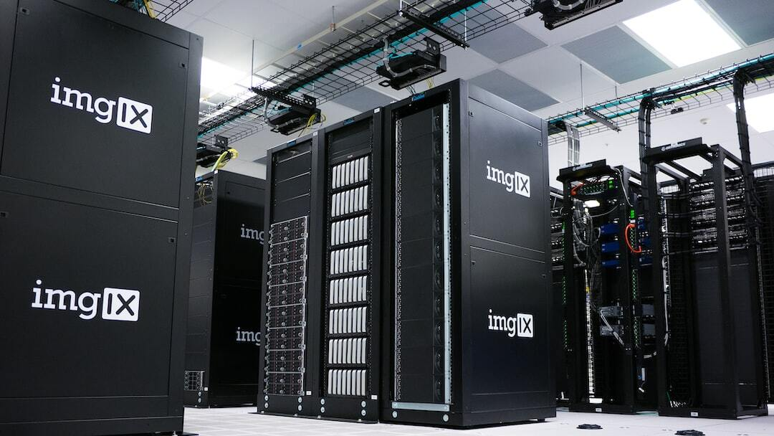
Backup Systems: Critical Importance
Backup System Importance: Maintaining reliable backup systems is essential for safeguarding critical data and ensuring business continuity in the event of data loss, system failures, or cyber incidents. Backups serve as a crucial insurance policy against unforeseen disruptions.
Image and Database Backups: Backing up both system images and databases is vital to preserve the integrity and functionality of IT infrastructure components. Image backups capture the entire system state, while database backups protect essential data assets.
Offsite Storage Risks: Storing backups at offsite facilities provides an additional layer of protection against on-premises disasters. However, offsite storage introduces risks related to accessibility, security, and data integrity that must be mitigated through robust backup practices.
Photo by imgix on Unsplash
Notes:
Effective backup systems are a cornerstone of cybersecurity resilience, ensuring data availability and continuity in the face of unforeseen events. This section explores the critical importance of backup systems, the significance of image and database backups, and the risks associated with offsite storage, emphasizing the need for robust backup strategies at Boldi AG.

Slide 7

Monitoring and Surveillance: 24/7 Coverage
Offsite Facility Monitoring: Continuous monitoring of offsite storage facilities to detect unauthorized access or suspicious activities in real-time
Real-time Alerts: Immediate notifications and alerts triggered by monitoring systems to ensure timely response to any potential security incidents
Photo by Nick Chong on Unsplash
Notes:
Maintaining 24/7 monitoring and surveillance of offsite storage facilities is crucial for detecting and responding to security threats in real-time. By implementing monitoring systems with real-time alert functionalities, Boldi AG can ensure swift action to mitigate any potential risks.

Slide 8

Cybersecurity Vulnerabilities: Identification and Patching
Identifying Vulnerabilities: Regular security assessments, penetration testing, and vulnerability scans to proactively identify weaknesses in systems and applications
Vulnerability Remediation: Prompt application of security patches, updates, and fixes to address identified vulnerabilities and prevent exploitation by attackers
Photo by Shahadat Rahman on Unsplash
Notes:
Proactively identifying and patching vulnerabilities is essential for maintaining a strong cybersecurity posture. Through regular security assessments and timely application of patches, Boldi AG can significantly reduce the risk of security breaches and protect sensitive data from exploitation.

Slide 9

Security Measures: Multi-Layered Approach
Firewalls: Network security devices that monitor and control incoming and outgoing network traffic based on predefined security rules to prevent unauthorized access
Antivirus Software: Software designed to detect, prevent, and remove malicious software such as viruses, worms, and trojans from computer systems
Intrusion Detection Systems: Security tools that monitor network or system activities for malicious activities or policy violations and generate alerts or take proactive actions
Encryption: The process of converting data into a code to prevent unauthorized access, providing a secure means of communication and data protection
Photo by Adi Goldstein on Unsplash
Notes:
Adopting a multi-layered security approach with firewalls, antivirus software, intrusion detection systems, and encryption is vital for safeguarding Boldi AG's digital assets. Each layer adds a defensive barrier to prevent cyber threats and protect sensitive information.

Slide 10

Training and Awareness: Employee Education
Cybersecurity Training: Educational programs and workshops to equip employees with knowledge and skills to recognize and respond to cyber threats effectively
Phishing Awareness: Training on identifying phishing emails, websites, and social engineering tactics to prevent falling victim to phishing attacks
Best Practices for Employees: Establishing protocols for password management, data handling, and device security to promote a security-conscious culture within the organization
Photo by Natanael Melchor on Unsplash
Notes:
Educating employees on cybersecurity best practices and raising awareness about common cyber threats like phishing are key components of a robust cybersecurity strategy. By providing training and resources for employees, Boldi AG can empower them to act as the first line of defense against cyber attacks.

Slide 11



Incident Response Plan: Preparedness and Execution
Developing Response Plan
Creating a structured framework outlining roles, responsibilities, and procedures for responding to security incidents in a coordinated and effective manner
Incident Handling Procedures
Establishing step-by-step guidelines for detecting, analyzing, containing, eradicating, and recovering from security breaches or incidents
Communication Protocols
Defining communication channels and protocols for internal and external stakeholders to ensure timely and accurate dissemination of information during security incidents
Notes:
Having a well-defined incident response plan is essential for minimizing the impact of security incidents and swiftly restoring operations. By establishing clear procedures, roles, and communication channels, Boldi AG can effectively respond to cybersecurity threats and reduce the risk of prolonged disruptions.

Slide 12
Regulatory Compliance: Meeting Industry Standards
Compliance Requirements
Adhering to industry-specific regulations, standards, and frameworks to protect sensitive data and maintain trust with customers and stakeholders
Data Protection Laws
Understanding and complying with data privacy laws such as GDPR, HIPAA, and CCPA to safeguard personal information and prevent data breaches
Industry Regulations
Following sector-specific regulations and guidelines to ensure the secure handling and storage of confidential data in compliance with industry standards
Certification Processes
Obtaining certifications and audits to demonstrate compliance with data protection regulations and industry standards, enhancing transparency and accountability
Notes:
Compliance with data protection laws and industry standards is paramount for Boldi AG to protect customer data and maintain regulatory trust. By understanding and adhering to compliance requirements, Boldi AG can establish a strong foundation for data security and build credibility with clients and regulatory authorities.

Slide 13



Digital Resilience: Adapting to Cyber Threats
Resilience Strategies
Implementing redundancy, disaster recovery plans, incident response testing, and continuous monitoring to ensure business continuity in the face of cyber incidents
Adapting to New Threats
Staying informed about emerging cyber threats, trends, and attack vectors to proactively adjust security measures and defenses accordingly
Continuous Improvement
Regularly assessing and enhancing cybersecurity measures, policies, and technologies to stay ahead of evolving threats and vulnerabilities
Notes:
Building digital resilience requires a proactive approach to cybersecurity that involves adapting to new threats, enhancing incident response capabilities, and continuously improving defense mechanisms. By prioritizing resilience strategies and embracing a culture of continuous improvement, Boldi AG can effectively mitigate cyber risks and strengthen its cybersecurity posture.

Slide 14


Security Certification Processes
Certification Requirements
Understanding and meeting industry-specific security certification requirements to demonstrate compliance and credibility
Validation Process
The process of validation and certification to ensure that security measures meet industry standards and best practices
Continuous Improvement
Implementing feedback from certification processes to enhance cybersecurity posture and continuously improve security measures
Notes:
Security certification processes are crucial for demonstrating compliance with industry standards and regulations. By adhering to certification requirements and undergoing validation processes, Boldi AG can validate their security measures and show their commitment to maintaining a robust cybersecurity posture. Continuous improvement based on certification feedback allows the organization to stay up-to-date with evolving security standards.

Slide 15

Digital Resilience Strategies
Resilience Planning: Developing strategies and plans to withstand and recover from cyber attacks, ensuring business continuity and data protection
Adapting to New Threats: Remaining agile and responsive to emerging cyber threats by continuously updating security measures and incident response plans
Continuous Improvement: Evaluating and enhancing digital resilience strategies to address evolving cyber threats and strengthen overall cybersecurity posture
Photo by Petter Lagson on Unsplash
Notes:
Digital resilience is essential for Boldi AG to navigate the ever-changing landscape of cyber threats. By proactively planning and adapting to new threats, the organization can fortify its defenses and minimize the impact of potential attacks. Continuous improvement in resilience strategies ensures that Boldi AG stays one step ahead of cyber adversaries and maintains a high level of cybersecurity preparedness.

